Slide 1
VI Semester Project
Face detection and recognition using LBP and SVM
Mentor: Dr. B.S. Sanjeev
Submitted by:
Abhinav Prakash(IIT2014046)
Ranju Panchariya (IIT2014004)
Anushka Jaiswal(IIT2014014)
Preshita Chaudhary(IIT2014024)

Slide 2
Motivation
Face recognition has gathered much attention in the recent years due to its applicability in various fields such as pattern recognition, biometrics, security etc.
The automatic tag feature suggests the social media users to label friends and acquaintances in photos and videos that saves time.
Face recognition helps in keeping confidential data secure and maintaining privacy. Also, surveillance by such systems have given satisfactory results.
Such technologies assist law enforcement agencies to identify suspects and find missing people.
It has also got its applications in verification and authentication such as unlocking software on mobile devices, PIN verification etc.

Slide 3
Objectives
To develop a fast and efficient system to detect faces quickly in cluttered backgrounds.
To implement a simple face recognition system and test it on multiple classes for measuring performance.
To implement a heuristic approach for face recognition.

Slide 4
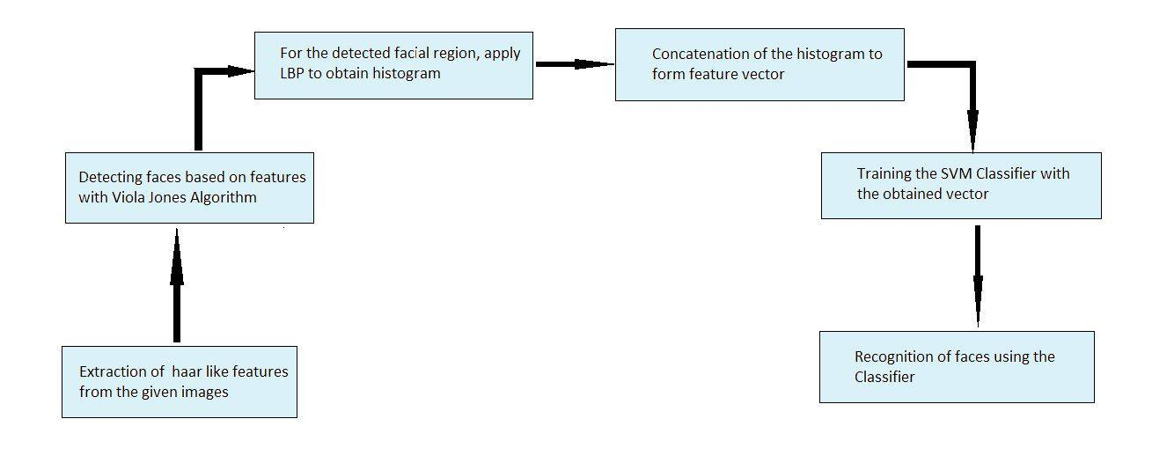
Methodology

Slide 5

Face Detection using Haar Cascades
1)Haar Feature selection:
Digital image features that are similar to haar wavelets are extracted as working with these features makes feature calculation less expensive.
Each feature is a single value obtained by:

Slide 6
2. Integral image:
To make the computation of sum of pixels easier, integral image process is used which contains sum of all left and upper pixels.
The integral image at location (x,y), is the sum of the pixels above and to the left of (x,y), inclusive.
3.Adaboost:
It is a training process that selects only those features that improves the predictive power of the model.
The final classifier is a weighted sum of weak classifiers that forms a strong classifier as a whole

Slide 7
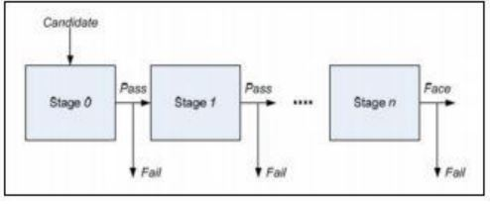
Cascade:
Face candidate images are eliminated by using a cascade of stages.
If all the stages are passed then the image is detected as desired result.

Slide 8
Feature Extraction using LBP:
Facial region being our region of interest is divided into several smaller regions from which features are extracted.
The LBP operator works with 8 neighbors of a pixel, using the value of the center pixel as its threshold. If a neighbor pixel has a higher gray value then the threshold, a 1 is assigned to that pixel, else it gets a 0.
The LBP code for the central pixel is produced by concatenating the values assigned to the 8 neighbors to form a binary representation.
Once the LBP for every pixel is calculated, the feature vector of the image can be constructed.

Slide 9
Continue..
If a face image is divided into 64 regions, for every region a histogram with all possible labels is constructed.
The feature vector is then constructed by concatenating the regional histograms into one big histogram.

Slide 10
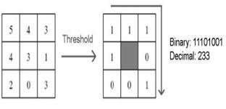
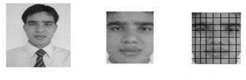
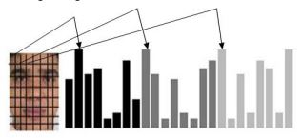
.

Slide 11
Support Vector Machine(SVM) for classification
SVM is a supervised learning model which analyzes data used for the classification.
An SVM training algorithm builds a model that assigns one category or the other for the test set.
From the training data we train the Support Vector Machine classifier with linear kernelization to classify our images. This gives us better accuracy then other kernels.

Slide 12
Heuristic Approach:
We select the label which has been recognized most of the time in order to improve our efficiency.

Slide 13
Applications of Face Recognition
Image database investigations
Personnel logging at various enterprises
Login at secure systems ( mobile phones, ATMs)
Military and intelligence
Law enforcement
General identity verification
Enhancement of security by using surveillance cameras.
Finding lost children's by using the images received from the cameras fitted at some public places .
Knowing in advance if some VIP is entering the hotel.
Detection of a criminal at public place.

Slide 14
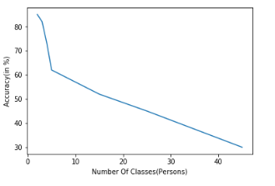
Result and Analysis:
Mean delay time is 0.6s.

Slide 15

Result

Slide 16
Thank You!

